Slide 1
Pods

Slide 2
What is Pod
It is a smallest scheduling unit in Kubernetes. It encapsulate one or more containers.
A pod can have one container or it can have multiple container running inside.

Slide 3
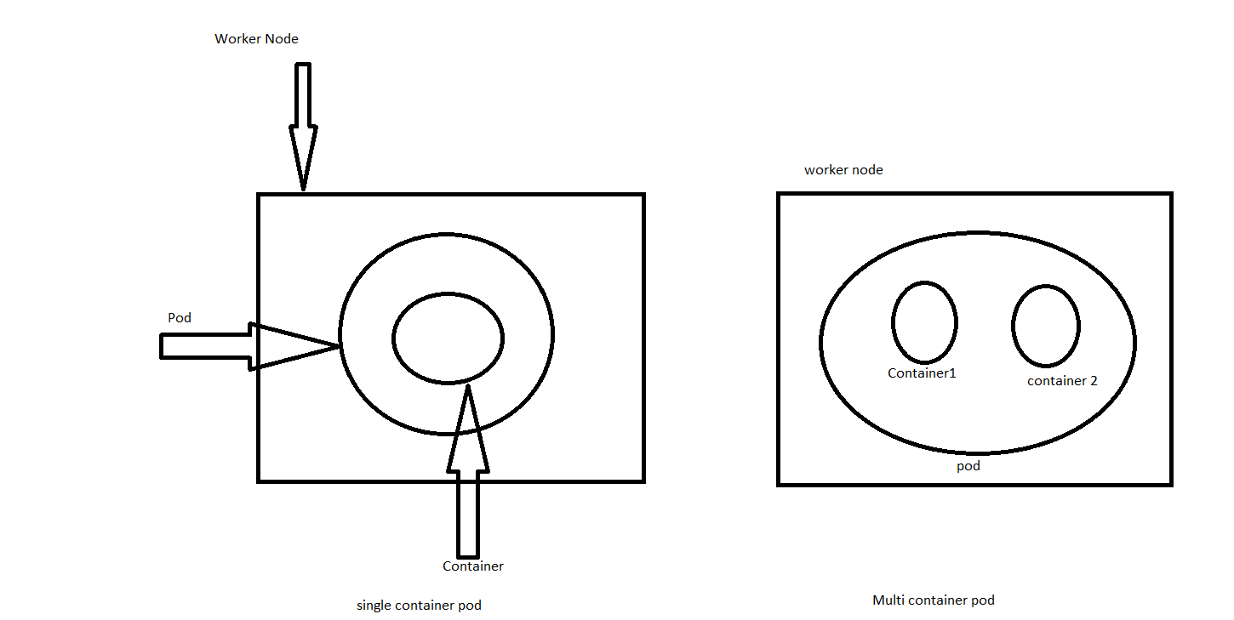

Slide 4
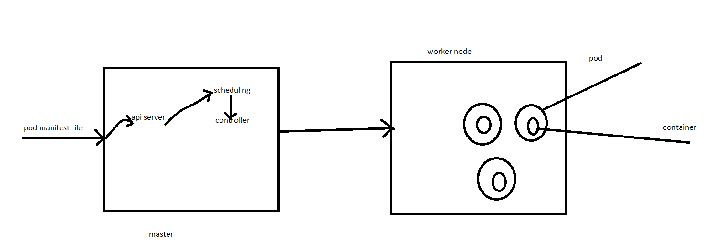
How a pod is created

Slide 5
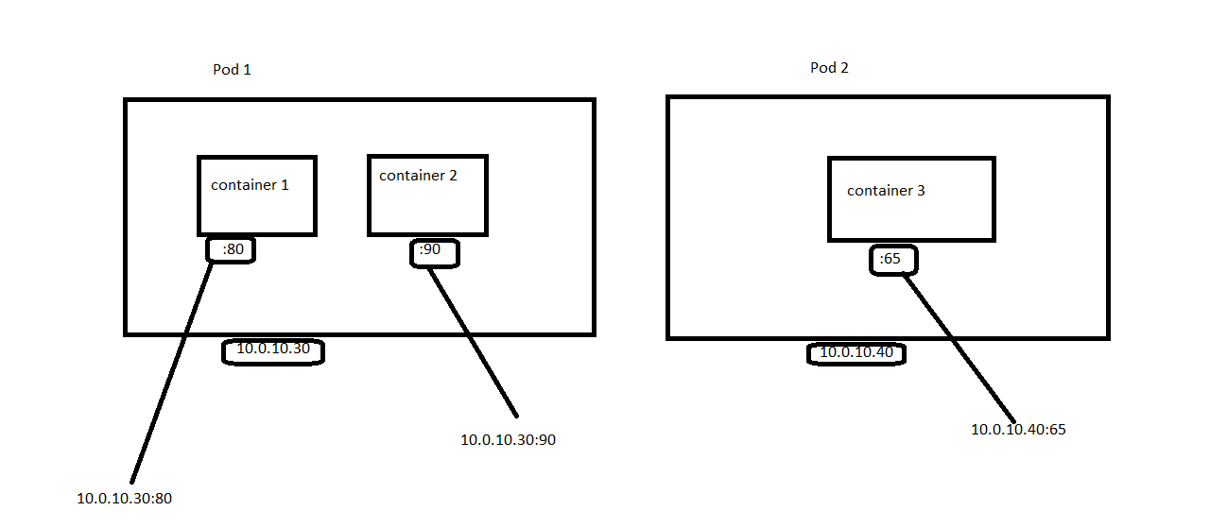
How to communicate with application inside the pod?

Slide 6
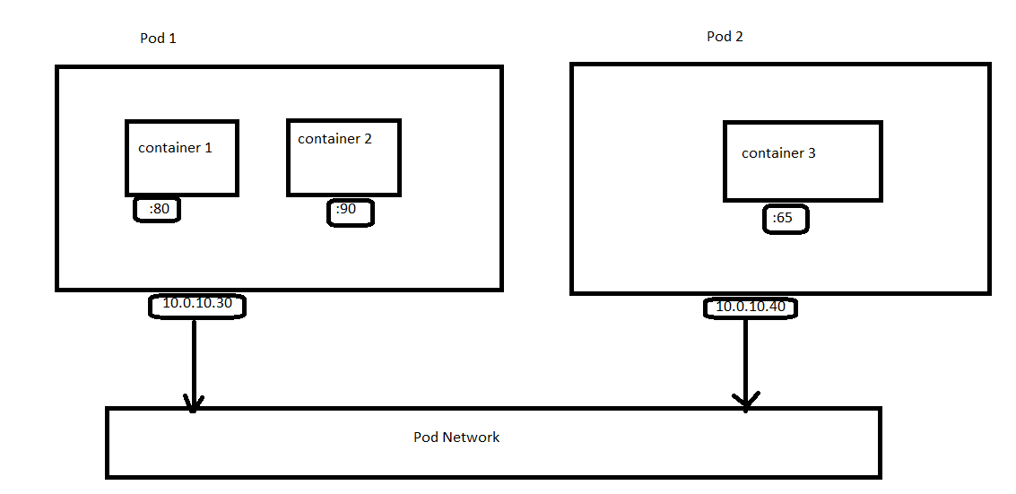
Inter-pod communication

Slide 7
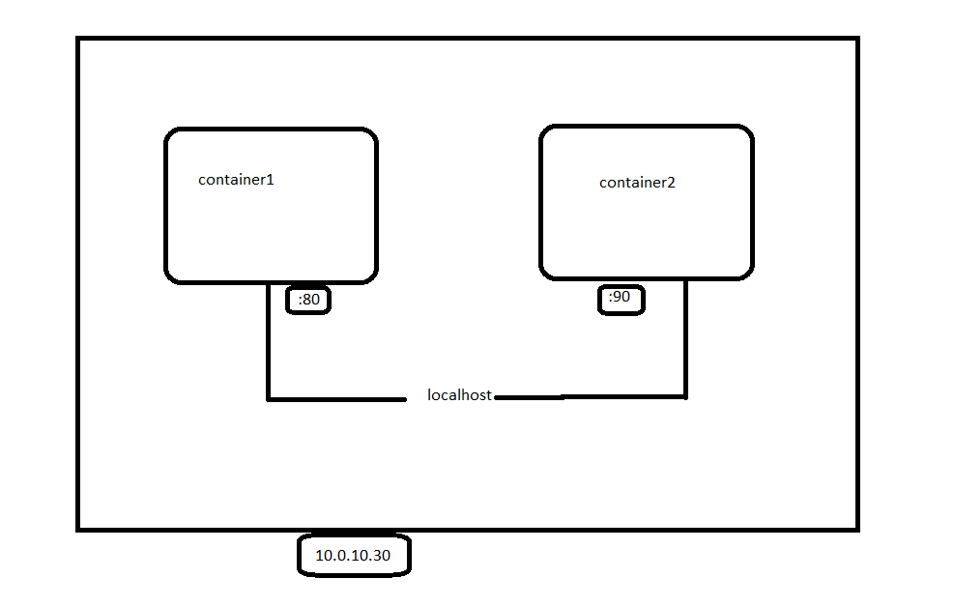
Intra-pod network

